Slide 1
Power Capping Via Forced Idleness
ANSHUL GANDHI
Carnegie Mellon Univ.
Mor Harchol-Balter Carnegie Mellon Univ. | Rajarshi Das IBM, T.J. Watson
Jeffrey O. Kephart IBM, T.J. Watson | Charles Lefurgy IBM, Austin
Notes:
Hello everyone. I am Anshul Gandhi, from Carnegie Mellon University, and I will be presenting our work on Power Capping Via Forced Idleness.
This is joint work with my advisor, Mor Harchol-Balter, and colleagues from IBM; Rajarshi Das and Jeff Kephart from IBM Watson, and Charles Lefurgy from IBM Austin.

Slide 2
Server Rack Power Consumption
30 kW
kW/racks
10 kW
2 kW
Problems: (1) Power delivery constraints
(2) Cooling requirements infeasible
Source: APC White Paper #46, 2005
Notes:
Let me begin this talk by looking at the recent trends in server rack power consumption. In the year 2005, the average power consumption per rack of servers was about 2 kW. And the worst case power consumption was about 10 kW. However, the high density racks we have today, such as blade server racks, can easily consume up to 30 kW of power.
This presents us with two major problems.
<CLICK>
First, the power delivery constraints. A 30 kW power supply will require a lot of 20A supply circuits, resulting in bulky and complex circuitry and wiring.
Second, the cooling requirements for a 30 kW server rack can be infeasible due to the very high power density, resulting in intense hot spots.
One common approach to running a high density server like this, is to use power capping.

Slide 3
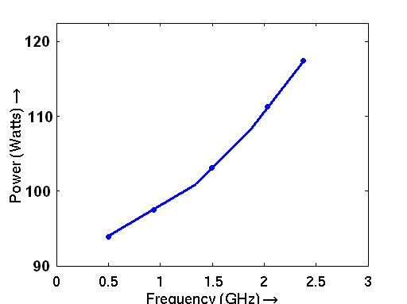
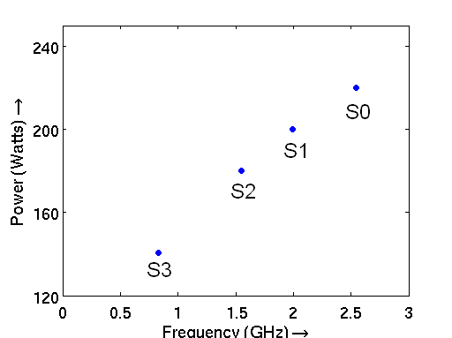
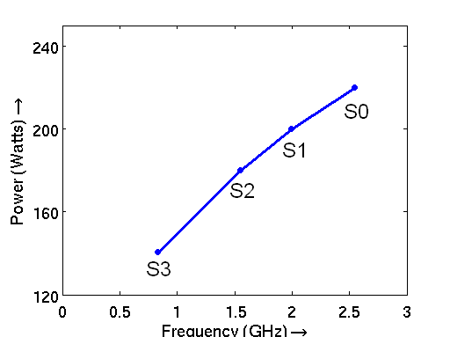
Power Capping
Limits average power consumption of servers over a
time interval to stay below specified threshold.
Clock-throttling
Lefurgy, Wang and Ware; ICAC, 2007.
Wang and Chen; HPCA, 2008.
Temperature (⁰F)
Power (watts)
Frequency (GHz)
Use clock-throttling or DVFS to control temperature.
Use clock-throttling or DVFS to control power consumption.
Notes:
Power capping limits the average power consumption of a server over a time interval to stay below a specified threshold.
Power capping has been developed and applied successfully in many cases, such as those by Lefurgy et. al in ICAC 2007 etc.
Let me explain a little more about how power capping works. Say we have the following Power to Frequency curve for a system, for a given workload, and we have four clock throttling states, S0, S1, S2 and S3.
<CLICK> Say we want to run our system at 200 Watts. This translates to using the <CLICK> S1 state, since it lies exactly on the 200 Watts line.
However, say we now wanted to run our server at 160 Watts. <CLICK> We now have two states that result in a power consumption close to 160 watts, <CLICK>, S2 and S3.
We can’t run at S2, since it results in more than 160 watts of average power consumption. We can run at S3, but clearly, it would be great if we had a throttling state exactly at 160 watts, so that we could get a higher server frequency than S3.
This is exactly what some power capping techniques, such as those developed by Lefurgy et al., do. <CLICK>
They essentially give us a continuous spectrum of throttling options rather than discrete ones.
Of course, the instantaneous power might exceed our threshold at a given point in time, but the time averaged power consumption within a required interval can be kept below the threshold by quickly dithering between adjacent states.
Thus, the idea is to use <CLICK> clock throttling or DVFS to control power consumption.
Just as power is affected by frequency, <CLICK> temperature is also affected by frequency, and sometimes you have to dither between adjacent frequency states to maintain a required temperature threshold.

Slide 4
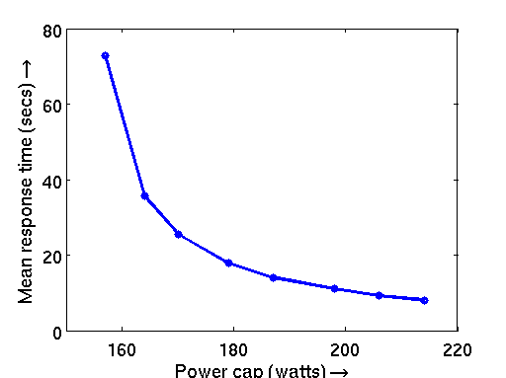
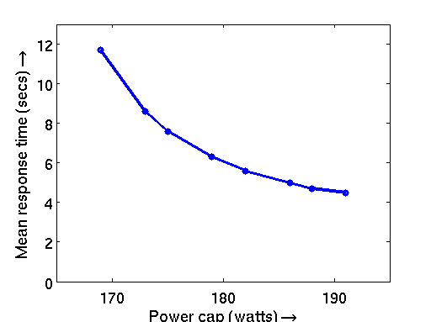
Effect on performance
CPU bound “DAXPY”
Memory bound “STREAM”
7X worse
3X worse
Mean Response Time (secs)
Mean Response Time (secs)
Clock-throttling
Clock-throttling
Power cap (watts)
Power cap (watts)
Significant performance loss across workloads
Source: Our experimental results on an IBM Blade
Notes:
We’ll now look at how power capping affects performance. In this talk, we’ll use mean response time as our performance metric. Response time of a job is defined as the time from when a job comes into the system to the time it leaves the system. <CLICK>
The graph here shows mean response time as a function of the power cap applied to the server for a CPU bound job DAXPY.
Clearly, <CLICK> <CLICK> as you lower the power cap from 210 watts to 160 watts, the RT goes up.
In fact, at the lowest power cap of 160 watts in this graph <CLICK>, we see that the mean response time increases to almost <CLICK> 7 times the mean response time at 210 watts.
<CLICK>
Likewise, <CLICK> as we reduce the power cap for a memory bound workload such as stream, we see an increase in mean response time. <CLICK> The maximum difference in response times in this case is about 3 times, since CPU frequency does not affect memory bound workloads as severely.
Clearly, while power capping is great for operating servers under power constraints, it is not good for performance <CLICK>. We are thus motivated to look for a better power capping approach than does that currently exist.

Slide 5
Goal
Dual Goal
IdleCap
Power Capping
Reduce Mean Response Time
IdleCap can reduce mean response time 2X-4X across workloads over existing power capping. (Results based on clock throttling)
Notes:
Our goal is two-fold. First, we want to ensure power capping. Also, we want to reduce mean response time over existing power capping techniques.
<CLICK> We call our approach IdleCap, <CLICK> and as we’ll show, IdleCap can reduce mean response time by two to four times over existing power capping techniques.
The results that I will show in this talk are based on clock throttling, however, at the end of this talk I’ll show how IdleCap extends to DVFS.

Slide 6
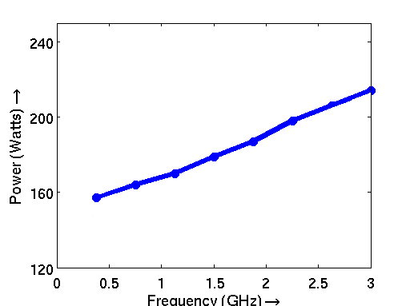
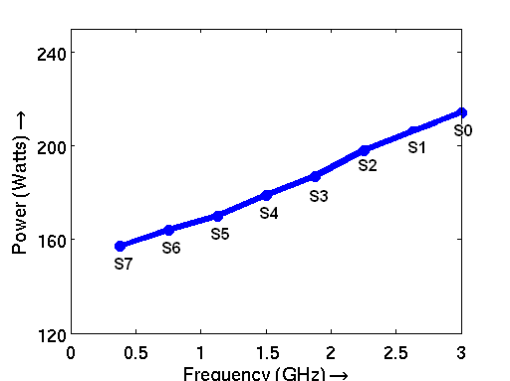
How IdleCap works
Existing power capping:
Dithers between adjacent states.
Power (watts)
Clock-throttling
IdleCap:
Dithers between extreme states: C1E, 3 GHz.
IdleCap
C1E
IdleCap achieves higher frequency for any power cap.
Frequency (GHz)
Notes:
Ok, so let’s look at how IdleCap works.
The graph here shows our measurements of power vs. frequency for CPU bound DAXPY workload.
Note that clock throttling results in a continuous power to frequency curve by dithering between adjacent states.
<CLICK>
If we extrapolate the blue curve all the way to the left, we see that the expected 0 GHz power should be close to 150 Watts.
<CLICK> However, most servers are equipped with advanced idle states, such as the C1E state shown here for our Intel based processor.
The C1E state has a power consumption of around 120 watts. The reason for this lower power consumption of C1E state is the lower operating voltage at C1E.
We exploit this low power idle state to create IdleCap, <CLICK>, which works by dithering between extreme states of 3 GHz and C1E.
As we see, <CLICK>, IdleCap is always below the blue curve, thus it achieves higher effective server frequency than existing power capping techniques for any power cap value.
Importantly, we alternate between full speed and idle state even when we have work to do.
Also, the transition time from going between the extreme states of 3 GHz and C1E is in the order of microseconds. Thus, we expect very little overhead in using IdleCap. This fact is validated via experiments that I’ll soon present.

Slide 7
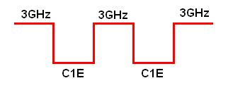
Example: 170 Watts
Clock throttling:
170 Watts → 0.7 GHz
Power (watts)
Clock-throttling
IdleCap:
170 Watts → 1.5 GHz
IdleCap
Same power cap, twice the frequency.
Frequency (GHz)
= 1.5 GHz
Notes:
Ok, so let’s look a simple example to make the point clearer.
Say we want a power cap of 170 watts.
For clock throttling, <CLICK> we get around <CLICK> .7 GHz of freq.
For IdleCap, <> we get <> 1.5 Ghz.
Thus, <> for the same power cap value, IdleCap results in twice the frequency.
In particular, <> IdleCap alternates between the 3GHz state and the C1E state, spending an equal amount of time in each state. This results in an average freq. of <> 1.5 GHz.

Slide 8
Analysis
Power Cap | IdleCap | r
170 W | 1.5 GHz | 1/2
195 W | 2.25 GHz | 3/4
Power (watts)
Clock-throttling
IdleCap
r: Fraction of time spent in 3 GHz state
Frequency (GHz)
Notes:
For 170 watts, we go between 3GHz and C1E, spending half the time in each state.
What if we wanted to achieve an arbitrary power cap value ?
Let’s first define some notation. <> We use ‘r’ to refer to the fraction of time IdleCap spends in the 3 GHz state. Thus, in our previous example, where we wanted a power cap of 170 watts, r was ½.
<CLICK> Say we now want a power cap of 195 watts. This would translate to spending ¼ of our time in the 120 watts C1E state, and ¾ of the time in the 3 GHz state. <CLICK> Thus, r = ¾.
<CLICK> In general, to achieve a power cap of Pcap watts, we pick the value of r to be as follows. This can be derived easily, and I will not go into this now. Details are presented in our paper.
Thus, we can pick the value of r appropriately for any power cap value we want.
Sometimes, we are interested in a power cap value that allows us to achieve a given performance SLA, such as a mean response time target.

Slide 9
Analysis
Mean Response Time when running at 3 GHz
Power Cap | IdleCap | r
170 W | 1.5 GHz | 1/2
195 W | 2.25 GHz | 3/4
Mean Response Time
with IdleCap
r: Fraction of time spent in 3 GHz state
Entirely Predictable
Notes:
Interestingly, IdleCap can be quite useful here. We introduce some more notation here.
E[To] refers to the mean response time of a job when running at 3 GHz, which means, no power capping.
<CLICK> Let E[Tidlecap] refer to the mean response time using IdleCap.
We can show, <CLICK> that E[Tidlecap] is equal to E[To] divided by r. This is because we are working on the job only for r fraction of time, and during that time, we are operating at full speed. Notice that this equation holds true irrespective of the workload type, since when we are in C1E, the system is halted as a whole, and not just the CPU.
Thus, <CLICK> the performance under IdleCap is entirely predictable.
So far, we have been talking about how great IdleCap is, and how it effortlessly exploits the Idle C1E state. We’ll now show via experimental results that this is in fact true.

Slide 10
Experimental Setup
IBM BladeCenter HS21
3GHz, quad core, 4GB RAM
C1E idle state
Workload
CPU bound (LINPACK, DAXPY)
Memory bound (STREAM)
Alternation period: Time between successive entries to C1E state
1millisec, 10millisec, 100millisec, 1sec, 10sec
Notes:
Let me first discuss our experimental setup.
<CLICK> Our server is an IBM BladeCenter HS21 blade, with a quad core 3 GHz CPU and 4 GB of RAM. It is equipped with the C1E idle state.
<CLICK> We experiment with a bunch of different workloads as shown. CPU bound workloads LINPACK and DAXPY, and memory bound STREAM.
<CLICK> Also, to establish the applicability of IdleCap in various scenarios, we experiment with a bunch of different alternation periods <CLICK>, where the alternation period is defined as the time between successive entries to the C1E state or the 3 GHz state.
So the alternation periods we experiment with range from 1 millisecond to 10 seconds.

Slide 11
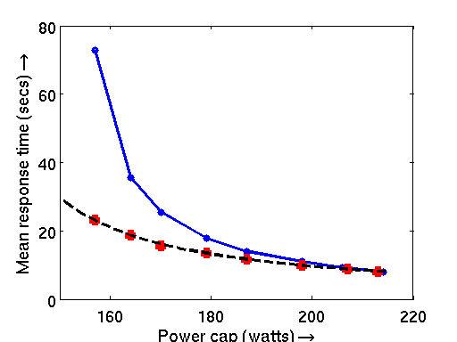
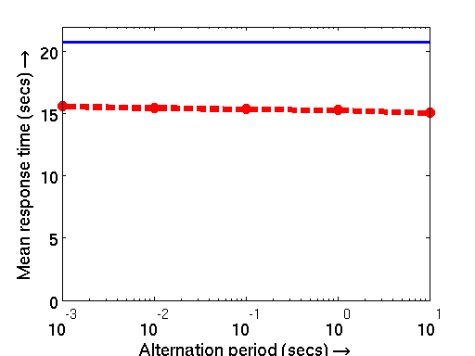
Results: “DAXPY”
Clock-throttling
Clock-throttling
Mean Response Time (secs)
Mean Response Time (secs)
IdleCap
IdleCap
IdleCap_{theory}
Power cap (watts)
Alternation period (secs)
Predicted E[T] = Observed E[T]
Overheads due to alternations: 6%
Up to 4X reduction in Mean response time.
Alternation period: 1 second
Notes:
We’ll start with the CPU bound DAXPY workload.
The graph here plots mean response time on the y-axis and the power cap value on the x-axis.
The blue curve represents power capping via clock throttling whereas the red dots represent IdleCap.
The black line represents our predicted mean response time for IdleCap based on the simple equation <CLICK> we saw before.
The first thing to note is that our experimental results for IdleCap match exactly with our theoretical predictions <CLICK>. Secondly, IdleCap outperforms existing clock-throttling based techniques throughout the range of power cap values, with a maximum improvement of up to 4 times <CLICK>.
The results presented here are for an alternation period of 1 second <CLICK>.
Let’s look at the results for other alternation periods now. Let’s fix the power cap at 180 watts and vary the alternation periods. <CLICK>. As we see, IdleCap’s performance is largely unchanged with the alternation period. Thus, IdleCap can be used in cases where a millisecond granularity is required in the average power consumption value.
The maximum difference in mean response time across alternation periods is as small as <CLICK> 6%.
Let us now consider the LINPACK workload.

Slide 12
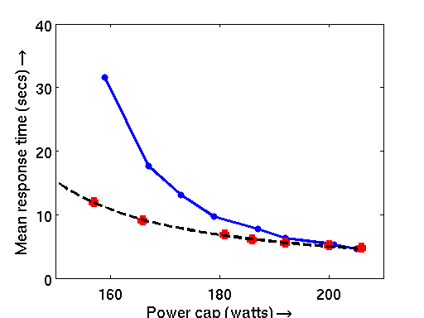
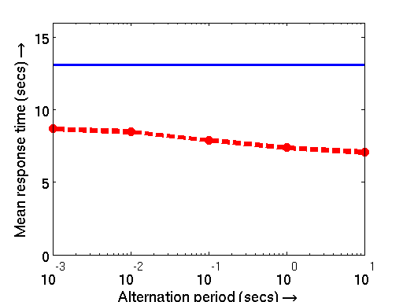
Results: “LINPACK”
Clock-throttling
Clock-throttling
Mean Response Time (secs)
Mean Response Time (secs)
IdleCap
IdleCap
IdleCap_{theory}
Power cap (watts)
Alternation period (secs)
Predicted E[T] = Observed E[T]
Overheads due to alternations: 15%
Up to 3X reduction in Mean response time.
Notes:
For LINPACK, we again find that our theoretical mean response time predictions for IdleCap match exactly with experimental results. Also, IdleCap outperforms clock-throttling based techniques throughout the power cap range, by as much as 3 times.
Finally, the maximum overhead due change in alternation period is 15%. This is because though LINPACK is CPU bound, it does use a fair bit of memory. DAXPY on the other hand, is tuned to be cache-resident.
Thus, for LINPACK, when we switch between 3 GHz and C1E, the memory fetch requests suffer.

Slide 13
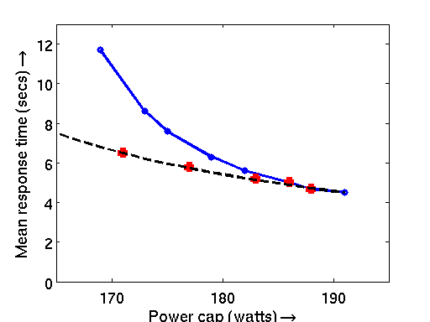
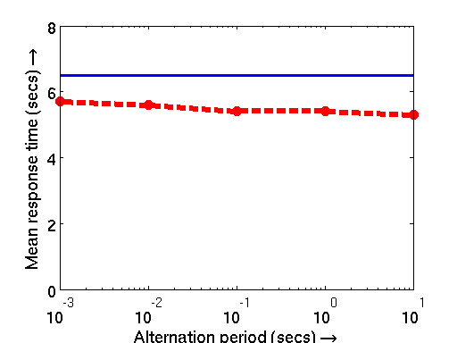
Results: “STREAM”
Clock-throttling
Clock-throttling
Mean Response Time (secs)
IdleCap
Mean Response Time (secs)
IdleCap_{theory}
IdleCap
Power cap (watts)
Alternation period (secs)
Predicted E[T] = Observed E[T]
Overheads due to alternations: 10%
Up to 2X reduction in Mean response time.
Notes:
Finally, here are our results for memory bound STREAM workload. Again, we find that IdleCap is consistently superior.

Slide 14
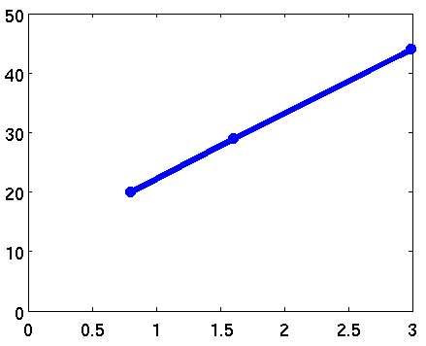
IdleCap and DVFS
Problem:
Concave upwards
Future:
Concave downwards
Power (watts)
DVFS
C1E
IdleCap
C6
Frequency (GHz)
Use advanced idle states (C6 on Intel).
Notes:
Ok, so now lets look at applying IdleCap to systems equipped with DVFS. DVFS is a technique similar to clock-throttling, except that we now change both the frequency and operating voltage of the machine.
Against DVFS <CLICK>, we find that our C1E state is not as power efficient. In fact, <CLICK> we have a concave upwards curve with C1E.
<CLICK> However, there are other advanced idle states, such as the C6 state that are more power efficient and result in a concave downwards curve.
Thus, <CLICK> by using these states, we can again use IdleCap to improve server frequency under power capping.

Slide 15
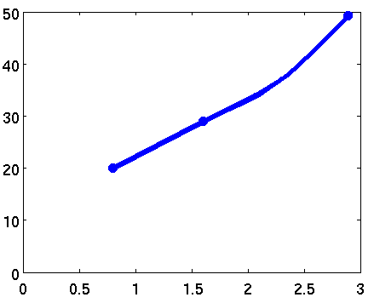
IdleCap and DVFS
Non-linear
Power (watts)
DVFS
IdleCap
C6
Frequency (GHz)
IdleCap applies to lower frequency range.
Notes:
Some processors such as the Nehalem, can exhibit a non-linear power to frequency relationship for DVFS, especially at the higher end of the frequency spectrum.
Even in such cases, we can apply IdleCap <CLICK>.
However, IdleCap will now alternate between an idle state and an in between DVFS state, which will be the knee of the curve as shown here.
<CLICK> Thus, for a non-linear power to frequency curve, we can still apply IdleCap to get higher server frequencies, however, this will only apply to the lower frequency range.

Slide 16
Conclusions
IdleCap is superior to existing power capping techniques based on clock throttling.
Applies to various workloads under alternation periods as small as 1 millisecond.
DAXPY
LINPACK
STREAM
Response Time (secs)
Response Time (secs)
Response Time (secs)
Mean Response Time (secs)
Mean Response Time (secs)
Power cap (watts)
Power cap (watts)
Power cap (watts)
Mean Response Time (secs)
Mean Response Time (secs)
Mean Response Time (secs)
Response Time (secs)
Response Time (secs)
Response Time (secs)
DAXPY
LINPACK
STREAM
Alternation period (secs)
Alternation period (secs)
Alternation period (secs)
Notes:
In conclusion, we have developed a new approach to power capping, called IdleCap, that is superior to existing power capping techniques, when applied to clock throttling. IdleCap is a versatile algorithm, applying to a wide range of workloads for all processor frequencies and a broad range of alternation periods, from milliseconds to 10s of seconds.

