Slide 1
Taming JavaScript on the Web
Arjun Guha Joe Gibbs Politz Shriram Krishnamurthi
+ Ben, Claudiu, Hannah, Matt, Dan

Slide 2
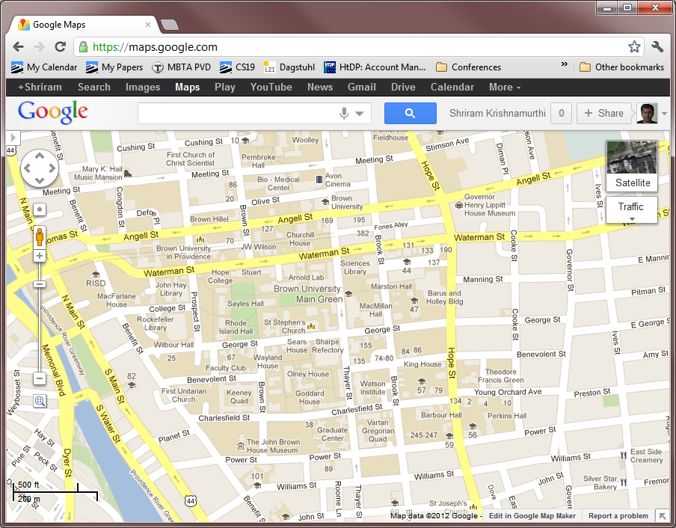

Slide 3
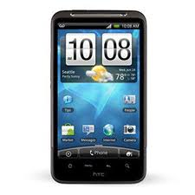
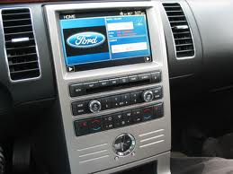
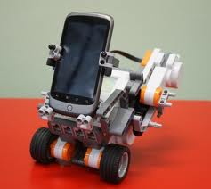
JavaScript is the new x86

Slide 4
mashups

Slide 5
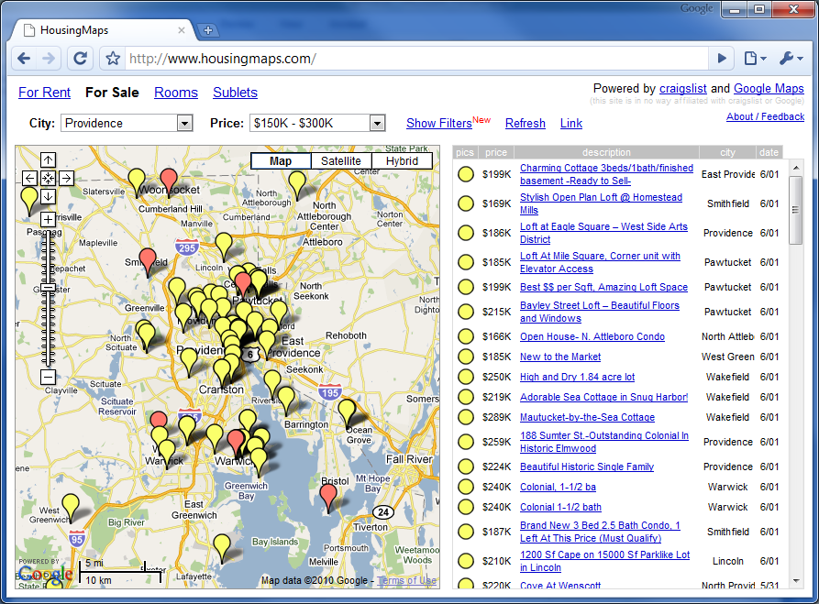

Slide 6
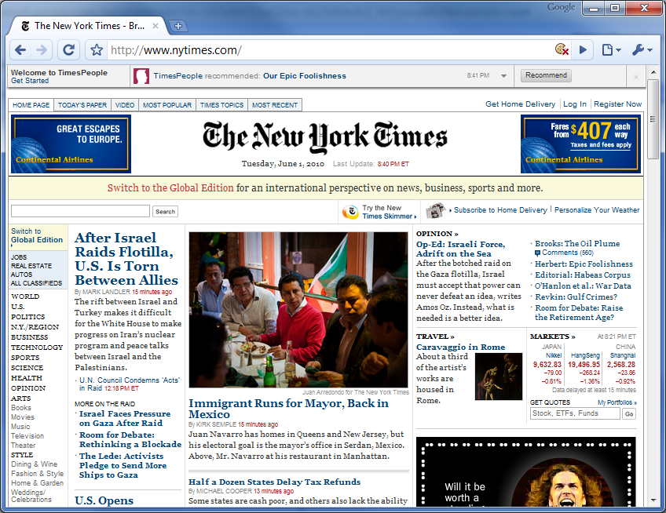

Slide 8
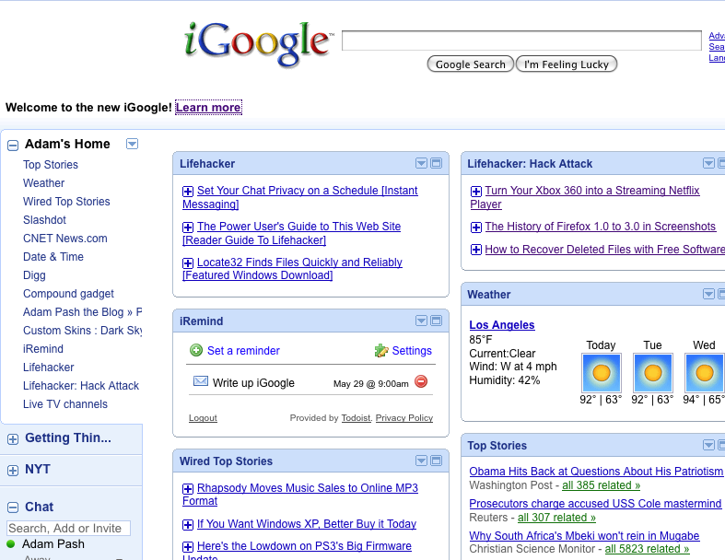

Slide 9
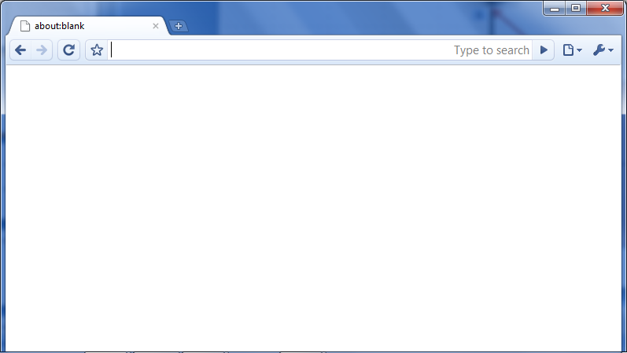
the host you visited
third- party server
JavaScript is the new Windows 3.1

Slide 10
// Redirect page
window.location = “citibank.com.evil.com”
// Change all links
links = document.getElementsByTagName(“a”);
for (var i = 0; I < links.length; i++) {
links[i].href = “track.com/fwd?” + links[i].href;
}
// Read cookies
document.cookie
// Read passwords
document.querySelector(‘input[type=password]’)
// Embed Flash, exploit, profit
document.write(‘
<object type=“application/x-shockwave-flash”
data=“evil.swf” />’);

Slide 11
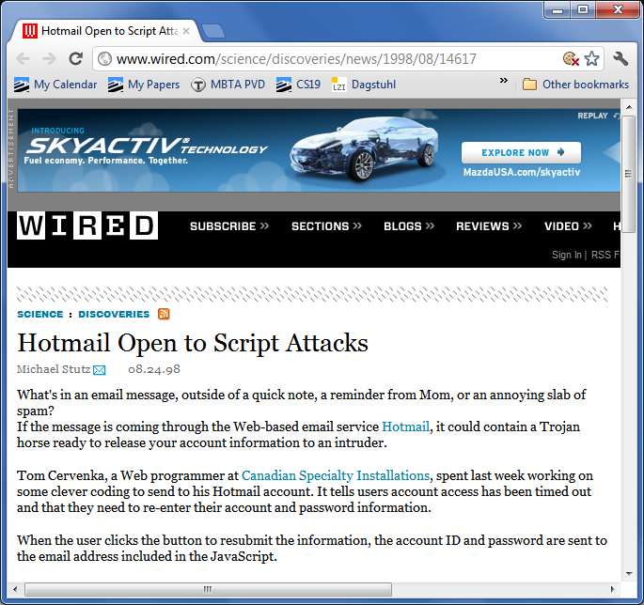
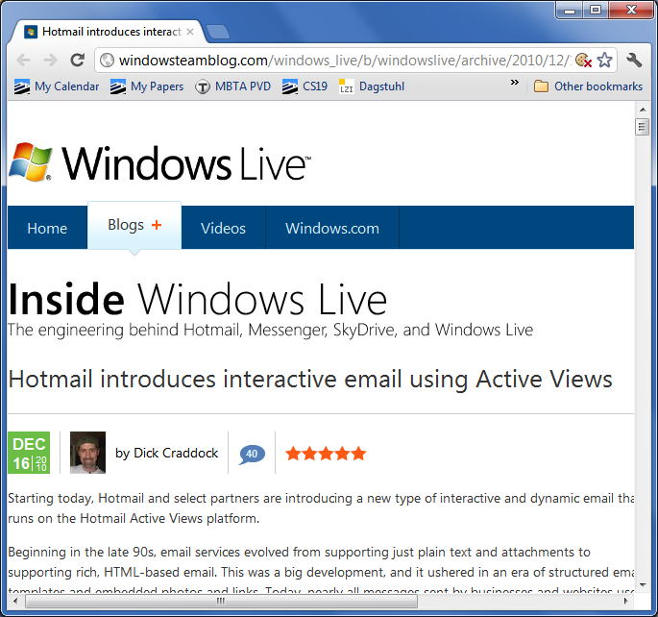
2010
1998

Slide 12
Microsoft Web Sandbox
Facebook JavaScript (FBJS)
Google Caja
Yahoo!
ADsafe
All are trying to define safe sub-languages

Slide 13
Talk Plan
Application
Verifying a sandbox
Tool
What we use for the verification: types
Foundation
What we need for the types: semantics

Slide 14
Web Sandboxing
Or, Safe Sub-Languages of JavaScript

Slide 15
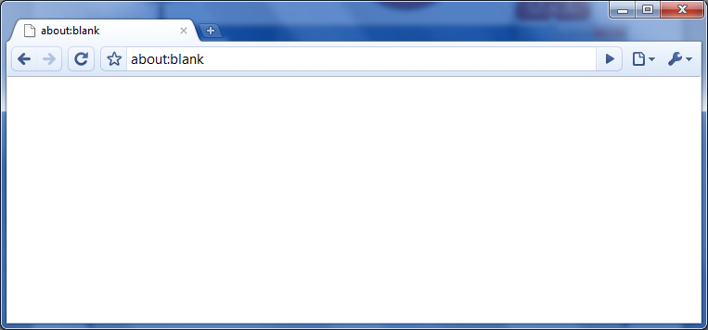
Static checks
eval
…
o.f
Wrappers
[A reference monitor] is tamper resistant, is always invoked, and cannot be circumvented.
—Anderson, October 1972
Rewriting
lookup
lookup(o, f)
?

Slide 16
…in fact, lookup is unsafe!
lookup =
function(o, fd) {
if (fd === “cookie”) {
return “unsafe!”; }
else {
return o[fd]; } }
Object as second argument
lookup (window,
{toString:
function () {
return “cookie”}})

Slide 17
window.setTimeout
element.appendChild
window.location
60 privileged DOM calls
50 calls to three assertions
40 type-tests
5 regexp checks
Whitelists, blacklists
function reject_global(that) {
if (that.window)
error();
}
if (typeof arg != ‘string’)
error();
if (/url/i.test(value[i])) {
error(‘ADsafe.error’);
}
banned = [‘eval’, `caller’,
`prototype’, …]

Slide 18
?
caplet list, 2007-09-30

Slide 19
Verifying adsafe

Slide 20
JSlint rejects
eval
…
JSlint passes
adsafe.js
ADSAFE = {
get: function(),
set: function(),
…};
ad.js
ADSAFE.get(o, x)
ADSAFE.set(o, x, y)
…

Slide 21
Definition (ADsafety): If all embedded widgets pass JSlint then:
Widgets cannot load new code at runtime, or cause ADsafe to load new code on their behalf,
Widgets cannot obtain direct references to DOM nodes,
Widgets cannot affect the DOM outside of their subtree,
Multiple widgets on the same page cannot communicate.
eval()
setTimeout()
document.write()
Function()
document.createElement()
<div id='AD'>
adsafe
widget
<img>
<p>
document
<div id=‘page’>
<div id='AD'>
widget1
adsafe
widget2

Slide 22
Goal: Verify adsafe.js
JSlint rejects
eval
…
JSlint passes
Assuming: Code has passed JSlint
adsafe.js
ADSAFE = {
get: function(),
set: function(),
…};
ad.js
ADSAFE.get(o, x)
ADSAFE.set(o, x, y)
…

Slide 23
JSlint in One Slide
Their version: 6371 LOC
Our version: ~15 LOC
Widget := Number + String + Boolean +
Undefined + Null +
* : Widget
__nodes__ : Array<Node>
caller : ☠
prototype : ☠
…
code : Widget × … → Widget
__proto__ : Object + Array + …

Slide 24
Claim
has the type
Widget
passes
JSLint
Passing JSLint is sufficient for ensuring ADsafety
We check this using test cases (~1100)

Slide 25
ADsafe library
Widget
HTMLElement
Widget
Widget
Widget
HTMLElement
Widget

Slide 26
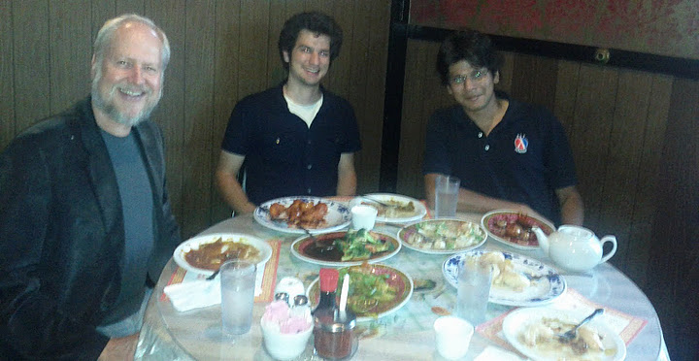
Definition (ADsafety): If all embedded widgets pass JSlint then:
Widgets cannot load new code at runtime, or cause ADsafe to load new code on their behalf,
Widgets cannot obtain direct references to DOM nodes,
Widgets cannot affect the DOM outside of their subtree,
Multiple widgets on the same page cannot communicate.
Found 2 arbitrary JavaScript execution bugs, and a number of other correctness bugs.
These were reported and fixed, and the fixed program type-checked.
eval()
setTimeout()
document.write()
Function()
document.createElement()
<div id='AD'>
adsafe
widget
<img>
<p>
?
document
<div id=‘page’>
<div id='AD'>
RETRACTED
widget1
adsafe
widget2

Slide 27
whence types?
Typed JavaScript from Guha’s PhD

Slide 28
Hidden evals, e.g., setTimeout:
function f() {alert(`Hello’);}
setTimeout(f, 1000);
var a = “alert(`Hello’)”;
setTimeout(a, 1000);

Slide 29
Global : {
eval : ☠
setTimeout : (Widget × … → Widget) × Widget → Widget
}
later: function(cb, time)
/*: Widget × Widget → Widget */
{
setTimeout(cb, time);
}
Includes non-functions …
… so it fails to typecheck
later: function(cb, time)
/*: Widget × Widget → Widget */
{
if(typeof cb === "function") {
setTimeout(cb, time); }
}
Typechecks because type has narrowed

Slide 30
later: function(cb, time)
/*: Widget × Widget → Widget */
{
if(typeof cb === "function") {
setTimeout(cb, time); }
}
Widget := Number + String + Boolean +
Undefined + Null +
* : Widget
__nodes__ : Array<Node>
caller : ☠
prototype : ☠
…
code : Widget × … → Widget
__proto__ : Object + Array + …
if(typeof cb === "function") {
setTimeout(CAST Widget × … → Widget cb,
time); }

Slide 31
Casting
Casting is an operation between types
But JavaScript (and Scheme, Python, …) have only tags
Tag = “number” | “string” | …
| {field: T, …} “object”
| T × … -> T “function”
So typeof should really be called tagof …

Slide 32
var slice = function (arr, start, stop) {
var result = [];
for (var i = 0; i <= stop - start; i++) {
result[i] = arr[start + i];
}
return result;
}
slice([5, 7, 11, 13], 0, 2)
[5, 7, 11]
slice([5, 7, 11, 13], 2)
arity mismatch error?

Slide 33
stop: Num ∪ Undef
var slice = function (arr, start, stop) {
if (typeof stop === "undefined") {
stop = arr.length – 1;
}
var result = [];
for (var i = 0; i <= stop - start; i++) {
result[i] = arr[start + i];
}
return result;
}
slice([5, 7, 11, 13], 0, 2)
[5, 7, 11]
slice([5, 7, 11, 13], 2)
→ [11, 13]
stop: Undef
stop: Num
stop: Num

Slide 34
var slice = function (arr, start, stop) {
if (typeof stop === "undefined") {
stop = arr.length – 1;
}
stop = CAST Number stop;
var result = [];
for (var i = 0; i <= stop - start; i++) {
result[i] = arr[start + i];
}
return result;
}
Note: Casting is an operation between types; “typeof” (JavaScript, Python, Scheme, …) inspects tags; thus we need to relate static types with dynamic tags

Slide 35
Checks For | JS Gadgets | ADsafe | Python stdlib | Ruby stdlib | Django | Rails
LOC | 617,766 | 2,000 | 313,938 | 190,002 | 91,999 | 294,807
undefined/null | 3,298 | 0 | 1,686 | 538 | 868 | 712
instanceof | 17 | 45 | 613 | 1,730 | 647 | 764
typeof | 474 | 40 | 381 | N/A | 4 | N/A
field-presence | unknown | unknown | 504 | 171 | 348 | 719
Total Checks | 3,789 | 95 | 3,184 | 2,439 | 1,867 | 2,195

Slide 36
Moral
“Scripting language” programmers use state and non-trivial control flow to refine types
What we need
Insert casts ➔ keeps type-checker happy
Do it automatically ➔ keeps programmer happy

Slide 37
{“Number”, “Undefined”}
stop: Num ∪ Undef
var slice = function (arr, start, stop) {
if (typeof stop === "undefined") {
stop = arr.length – 1;
}
var result = [];
for (var i = 0; i <= stop - start; i++) {
result[i] = arr[start + i];
}
return result;
}
{“Number”}
{“Undefined”}
stop = CAST Number stop;
{“Number”}
Use flow analysis over tag sets
Heap-, flow-sensitive…
…but intraprocedural
Flow analysis automatically calculates casts

Slide 38
Our Recipe
Simple type checker (not quite enough)
Add casts (breaks progress)
Standard flow analysis (w/ preservation broken)
“Types on the outside, flows on the inside”
The composition is sound
The performance is great (seconds on netbook)

Slide 39
Whence Theorems?

Slide 40
> [] + []
// empty string
> [] + {}
[object Object]
> {} + []
0
> {} + {}
NaN
https://www.destroyallsoftware.com/talks/wat/
Gary Bernhardt

Slide 41
“a string” – “another string”
→ NaN
Arithmetic doesn’t signal errors
No arity mismatch errors
Reading non-existent field → undefined
Writing non-existent field → creates field
Unbound identifiers → same story
Breaching array bounds → undefined
Prototypes, oh prototypes!
JavaScript is the new C

Slide 42
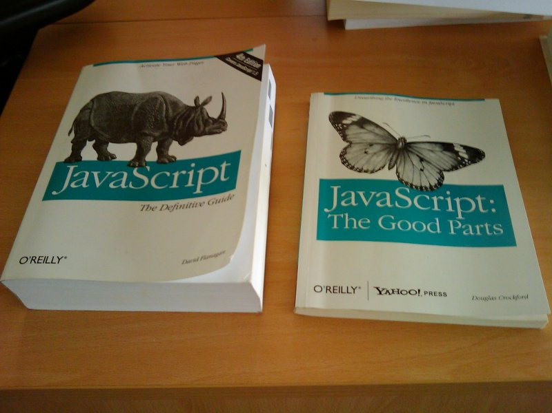
Thanks, Emery Berger

Slide 43
to soundly enforce the policies mentioned above, […] needs to statically reason about the program heap. To this end, this paper proposes the first points-to analysis for JavaScript
In our staging framework, the heavyweight flow analysis is carried out just once on the server and its results are distilled into succinct residual checks, that enjoy two properties. First, they soundly describe the properties that are left to be checked on the remaining code once it becomes known
We present a static program analysis infrastructure that can infer detailed and sound type information for JavaScript programs using abstract interpretation.

Slide 44
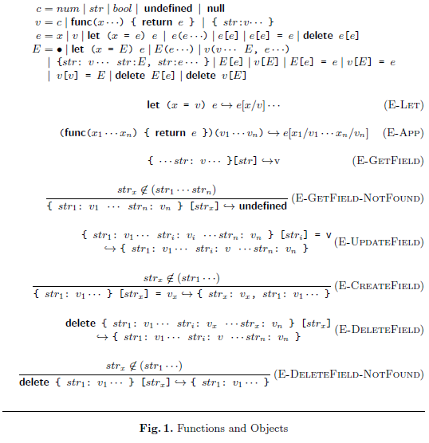
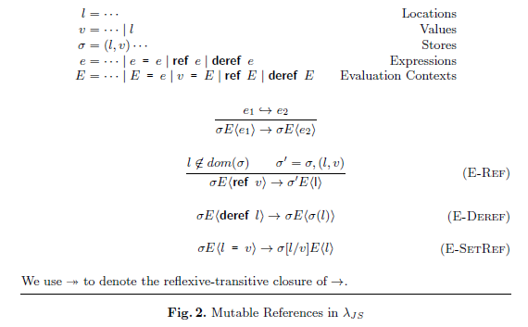
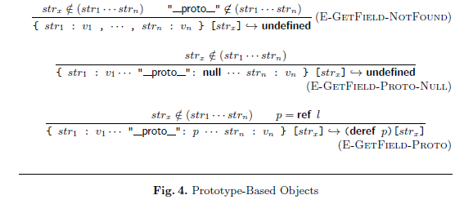
λ_{JS} (sort of) on one slide

Slide 45
JavaScript program
desugar
λ_{JS} program
SpiderMonkey, V8, Rhino
100 LOC interpreter
“their answer”
“our answer”
identical for portion of Mozilla JS test suite

Slide 46
Verifying Web Browser Extensions, MSR
Aspects for JavaScript, U Chile
System !D, UCSD
Formal Specification of JavaScript Modules, KAIST
JavaScript Abstract Machine, Utah and Northeastern
Deriving Refocusing Functions, Aarhus
Information Flow Analysis, Stevens Tech
0CFA, Fujitsu Labs (patent pending)

Slide 47
www.jswebtools.org
DOM Event Semantics
(akin to λ_{JS})
New Theory of Objects for Scripting Languages
Analyzing Browser Extensions
λ_{JS} now in Coq
Program
Synthesis from Alloy specs
(Alchemy)
Flapjax:
Reactive
Programming
Progressive Types
Intrusion Detection via Static Analysis
Capabilities for
Authentication and Sharing (Google Belay)

