Slide 1
Intel Concurrent Collections (for Haskell)
Ryan Newton*, Chih-Ping Chen*, Simon Marlow+
*Intel
+Microsoft Research
Software and Services Group
Jul 29, 2010

Slide 2
Goals
Streaming/Actors/
Dataflow
Push Parallel Scaling in Haskell
Never trivial
Harder with: Laziness, complex runtime
Offer another flavor of parallelism:
Explicit graph based
C
n
C
a `par` b
forkIO$ do…
Pure operand parallelism
Threaded parallelism
Data Parallelism
[: x*y | x<-xs | y<-ys :]

Slide 3
Intel Concurrent Collections (CnC)
These models: A bit more domain specific (than, say, futures)
A payoff in parallelism achieved / effort
CnC is approximately:
stream processing + shared data structures
Intel CnC: A library for C++
Also for Java, .NET thanks to Rice U. (Vivek Sarkar et al)
Yet… CnC requires and rewards pure functions -- Haskell is a natural fit.
Streaming/Actors/
Dataflow
C
n
C

Slide 4
Goals
How would I (typically) do message passing in Haskell?
Push Parallel Scaling in Haskell
Never trivial
Harder with: Laziness, complex runtime
Offer another flavor of parallelism:
Explicit graph based
a `par` b
forkIO$ do…
Pure operand parallelism
Threaded parallelism
Data Parallelism
[: x*y | x<-xs | y<-ys :]

Slide 5
Message passing in Haskell
IO Threads and Channels:
do action..
writeChan c msg
action..
do action..
readChan c
action..
This form of message passing sacrifices determinism. Let’s try CnC instead…

Slide 6
CnC Model of Computation
Tasks not threads
Eager computation,
Takes tag input,
Runs to completion
Step reads data items
Step produces data items
“Cnc Graph” = network of steps
DETERMINISTIC
tags items
tags items
tag
1:
34
1:
‘a’
2:
2:
λ tag. Step
3:
Step
3:
‘f’
4:
99
4:
‘z’
5:
5:
6:
6:
tags
There’s a whole separate story about offline analysis of CnC graphs - enables scheduling, GC, etc. No time for it today!

Slide 7
How is CnC Purely Functional?
Domain
Range

Slide 8
How is CnC Purely Functional?
A set of tag/ item collections
Updates (new tags, items)
MyStep
Domain
Range

Slide 9
An CnC graph is a function too
A set of tag/ item collections
A complete
CnC Eval
Domain
Range

Slide 10
Message passing in Haskell
IO Threads and Channels:
Steps, Items, and Tags
do action..
writeChan c msg
action..
Step1
do action..
readChan c
action..
Step2
This form of message passing sacrifices determinism. Let’s try CnC instead…

Slide 11
Haskell / CnC Synergies
 | C++ incarnation | Haskell incarnation
CnC Step | hopefully pure execute method | Pure function Enforce step purity.
Complete CnC Graph Execution | Graph execution concurrently on other threads. Blocking calls allow environment to collect results. | Pure function. Leverage the fact that CnC can play nicely in a pure framework.
Also, Haskell CnC is a fun experiment.
We can try things like idempotent work stealing!
Most imperative threading packages don’t support that.
Can we learn things to bring back to other CnC’s?

Slide 12
How is CnC called from Haskell?
Haskell is LAZY
To control par. eval granularity Haskell CnC is mostly eager.
When the result of a CnC graph is needed, the whole graph executes, in parallel, to completion.
(e.g. WHNF = whole graph evaluated)
Fork workers
Par exec.
Need result!
Recv.
result

Slide 13
A complete CnC program in Haskell
myStep items tag = do word1 <- get items "left" word2 <- get items "right" put items "result" (word1 ++ word2 ++ show tag) cncGraph = do tags <- newTagCol items <- newItemCol prescribe tags (myStep items) initialize$ do put items "left" "Hello " put items "right" "World " putt tags 99 finalize$ do get items "result" main = putStrLn (runGraph cncGraph)

Slide 14
Initial Results

Slide 15
I will show you graphs like this:
(4 socket 8 core Westmere)

Slide 16
Current Implementations
Thread per step instance.
IO based + pure impl.s
Lots of fun with schedulers!
Lightweight user threads (3)
Data.Map of MVars for data.
Global work queue (4,5,6,7,10)
Continuations + Work stealing (10,11)
Simple Data.Sequence deques
Haskell “spark” work stealing (8,9)
(Mechanism used by ‘par’)
Cilkish sync/join on top of IO threads
Step(0)
Step(1)
Step(2)
…
thr1
thr2
thr3
wrkr1
wrkr2
wrkr3
Global work pool
wrkr1
wrkr2
Per-thread work deques

Slide 17
Back to graphs…

Slide 18
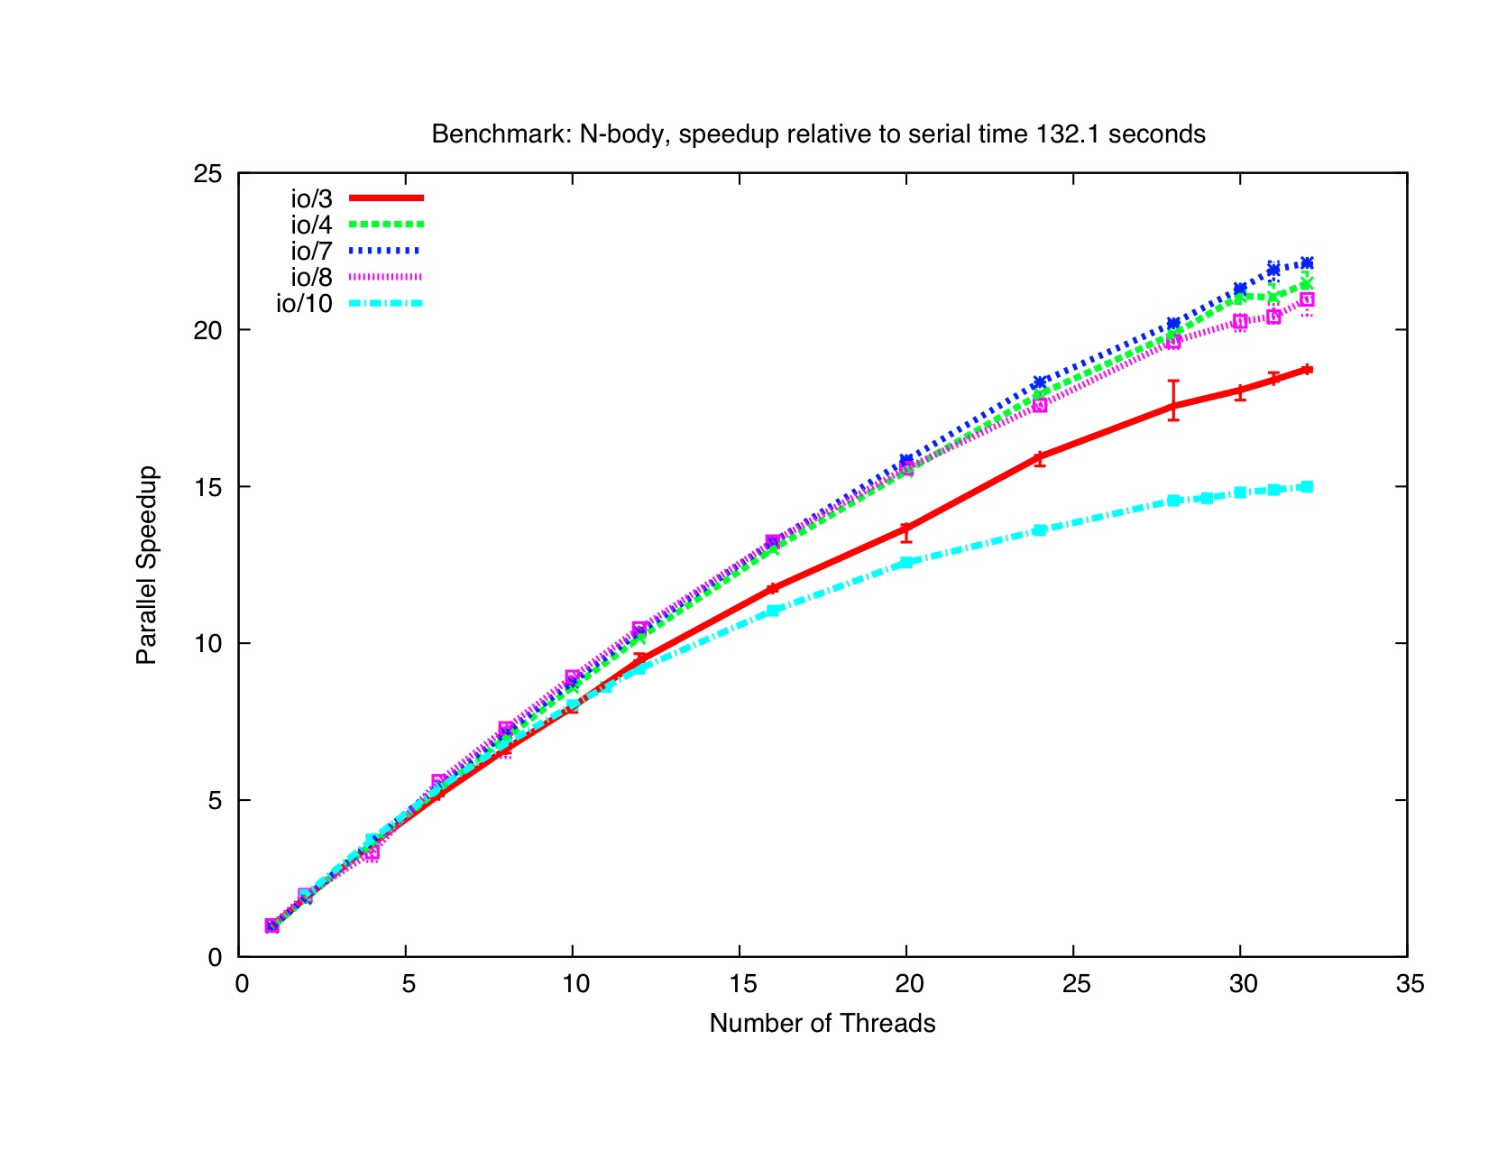
Recent Results

Slide 19
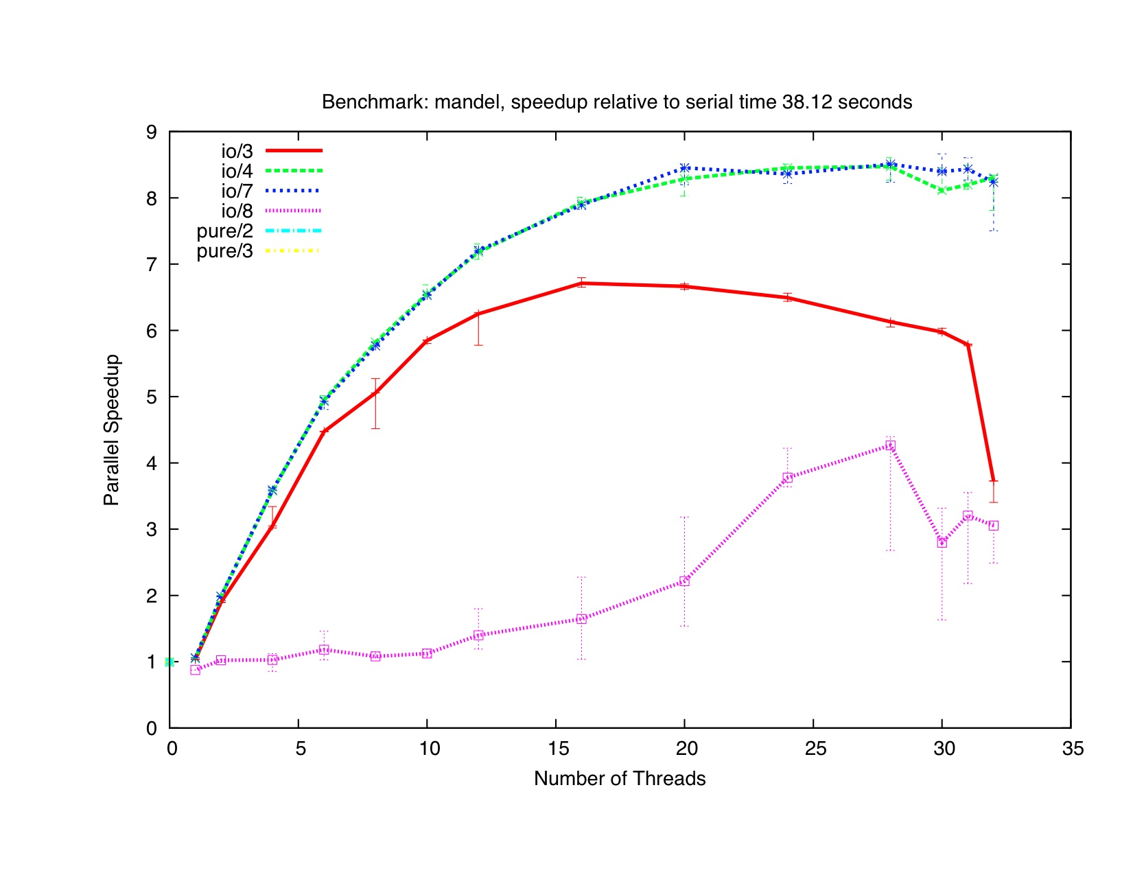
Recent Results

Slide 20
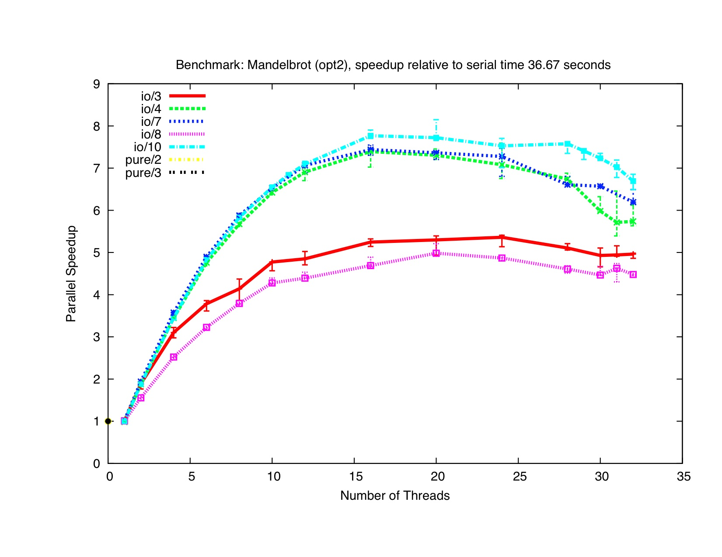
Recent Results

Slide 21
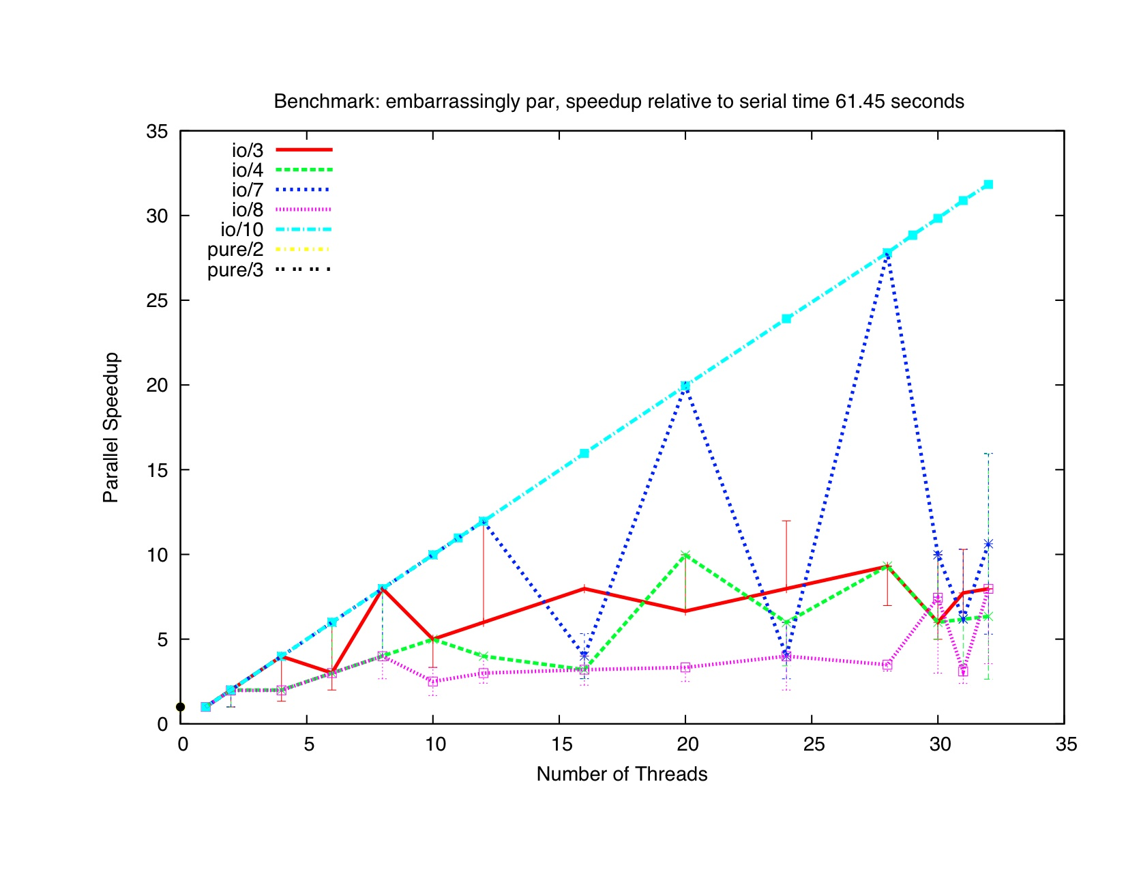
One bit of what we’re up against: Example: Tight non-allocating loops

Slide 22
Conclusions from early prototype
Lightweight user threads (3) ➔ simple, predictable, but too much overhead
Global work queue (4,5,6,7,10) ➔ better scaling than expected
Work stealing (11) ➔ will win in the end, need good deques!
Using Haskell “spark” work stealing (8,9) ➔ a flop (for now)
No clear scheduler winners! CnC mantra - separate tuning (including scheduler selection) from application semantics.

Slide 23
Conclusions
Push Scaling in Haskell
Overcame problems (bugs, blackhole issues)
GHC 6.13 does *much* better than 6.12
Greater than 20X speedups
A start.
GHC will get scalable GC (eventually)
A fix for non-allocating loops may be warranted.
It’s open source (Hackage) - feel free to play the “write a scheduler” game!
See my website for the draft paper! (google Ryan Newton)

Slide 25
Future Work, Haskell CnC Specific
GHC needs a scalable garbage collector (in progress)
Much incremental scheduler improvement left.
Need more detailed profiling and better understanding of variance
Lazy evaluation and a complex runtime are a challenge!

Slide 26
Moving forward, radical optimization
Today CnC is mostly “WYSIWYG”
A step becomes a task (but we can control the scheduler)
User is responsible for granularity
Typical of dynamically scheduled parallelism
CnC is moving to a point where profiling and graph analysis enable significant transformations.
Implemented currently: Hybrid static/dynamic scheduling
Prune space of schedules / granularity choices offline
Future: efficient selection of data structures for collections (next slide)
Vectors (dense) vs. Hashmaps (sparse)
Concurrent vs. nonconcurrent data structures

Slide 27
Tag functions: data access analysis
How nice -- a declarative specification of data access! (mystep : i) <- [mydata : i-1], [mydata : i], [mydata : i+1]
Much less pain than traditional loop index analysis
Use this to:
Check program for correctness.
Analyze density, convert data structures
Generate precise garbage collection strategies
Extreme: full understanding of data deps. can replace control dependencies

